Slide 1
“Online Blockchain Based Certificate
Generation and Validation”

Slide 2
Motivation
Interest in Technology: Many individuals are drawn to blockchain technology due to its innovative nature. They find the concept of decentralized and secure ledgers fascinating and want to be a part of its development.
Problem Solving: Blockchain technology has the potential to address various real-world issues, such as identity management, supply chain transparency, and financial inclusion. Those who are motivated by solving complex problems and making a positive impact on society might be drawn to blockchain.
Solving Real-World Problems: Some people are motivated by the prospect of addressing real-world problems, such as counterfeit certificates and diploma mills. Blockchain technology can be a practical solution to these issues.

Slide 3

Introduction
In today's digital age, the need for secure and convenient methods of certificate generation and validation is paramount. This documentation outlines our project, "Blockchain Innovator," which addresses the inherent security challenges in traditional certificate management systems. Our mission is to provide a seamless and secure platform for generating and validating certificates using blockchain technology.

Slide 4

Literature Survey
Blockchain Technology in Education:
Blockchain technology has gained significant attention in the education sector for its potential to secure and streamline certificate generation and validation processes.
Decentralized Identity and Self-Sovereign Identity:
Many projects and research papers focus on the concept of self-sovereign identity using blockchain, which allows individuals to have control over their digital certificates and credentials.
Tamper-Proof Certificates:
Blockchain's immutability ensures that certificates are tamper-proof, and this feature is essential for the security of educational credentials.
Smart Contracts for Certificate Issuance:
Smart contracts on blockchain platforms can automate the certificate issuance process, ensuring that certificates are only issued when certain criteria are met.

Slide 5

5. Security and Privacy:
Research has been conducted on how blockchain can enhance the security and privacy of certificate data, ensuring that personal information is protected.
6. Use of Public vs. Private Blockchains:
Some projects explore the choice between public and private blockchains for certificate issuance and validation, each with its own set of advantages and challenges.
7. Credential Verification Systems:
There is a growing need for blockchain-based systems that allow employers and institutions to easily verify the authenticity of certificates issued on the blockchain.
8. User-Friendly Interfaces:
Research and development have focused on creating user-friendly interfaces for certificate holders and verifiers to access and verify blockchain-based certificates.

Slide 6
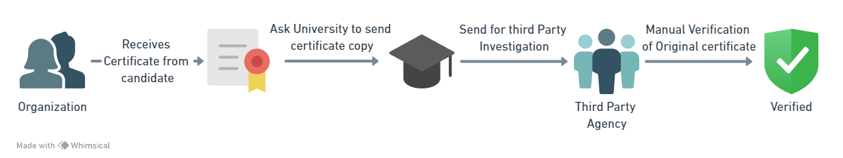

Existing System :
Certificates are easily damaged or stolen because they're just papers or digital files stored on computers.
Checking if certificates are real takes a long time and is not very reliable. You must talk directly to the people who gave you the certificates.
The current system doesn't do a good job of stopping people from making fake certificates. Some people could change their certificates to lie about their qualifications.

Slide 7
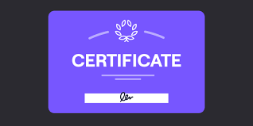
Proposed System :
The traditional way of creating and checking certificates has some big problems. One major issue is that it's too easy for people to make fake certificates, and this can lead to false claims about their qualifications. Also, it's hard to be sure if a certificate is real or fake because there's no reliable and standard way to check. This affects not only individuals but also educational institutions and employers. Our project, "Online Blockchain-Based Certificate Generation and Validation," aims to solve these important problems. We use blockchain technology to make certificates secure and unchangeable. Our goal is to provide a trustworthy and transparent solution that ensures certificates are real and valuable in our digital world.

Slide 8
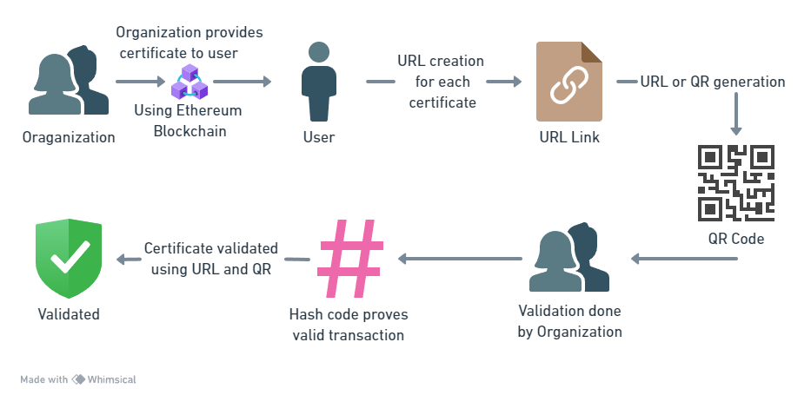
System Architecture:

Slide 9
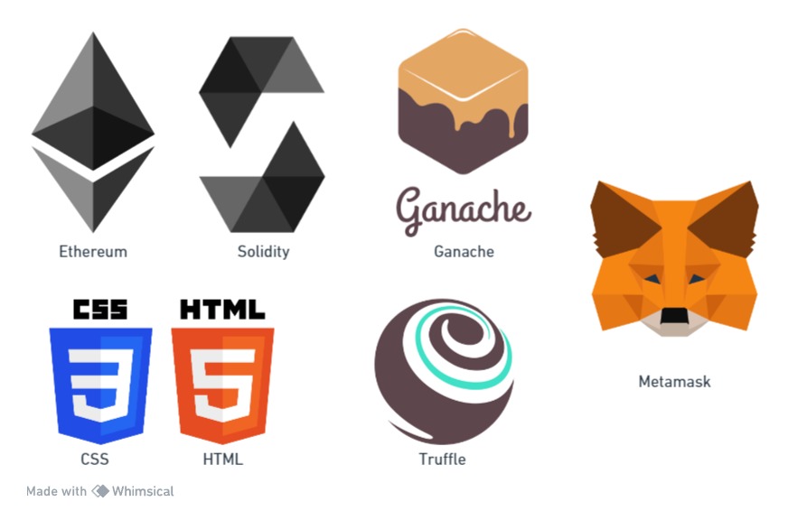

Technological Stack:
Ethereum – Immutable blockchain platform that Serves as a public distributed ledger
Solidity – Programming Language for blockchain
Ganache – provide fake ethers for testing on the test net
Truffle – Test environment
Metamask - Wallet
HTML and CSS – Programming Front End

Slide 10
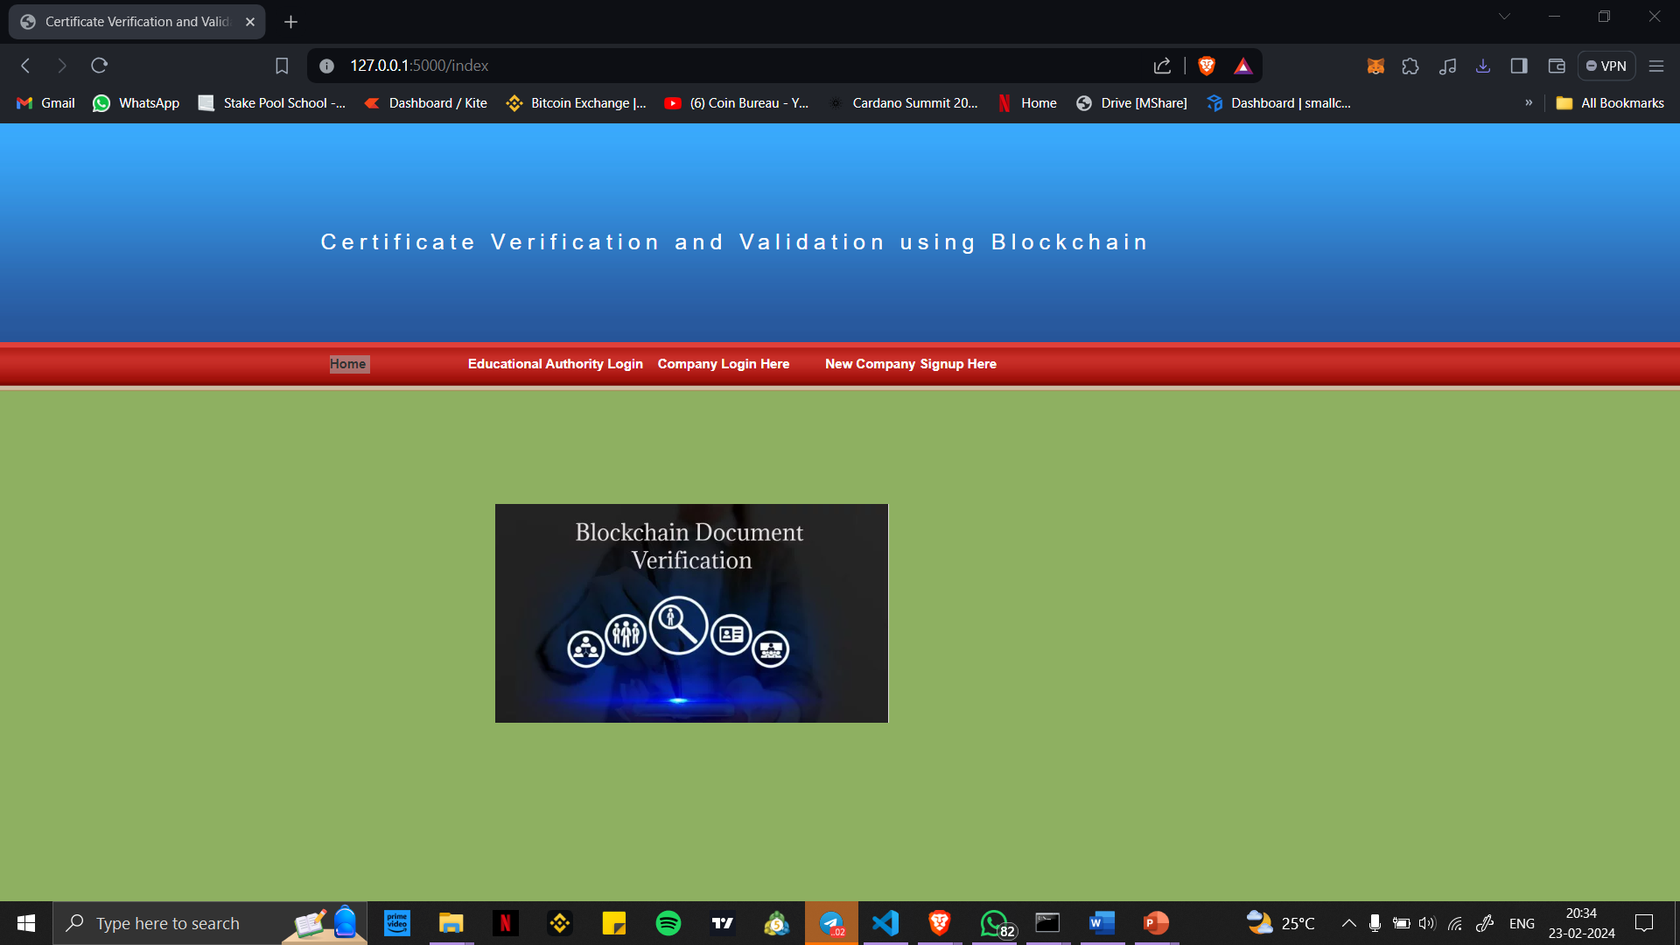

Slide 11
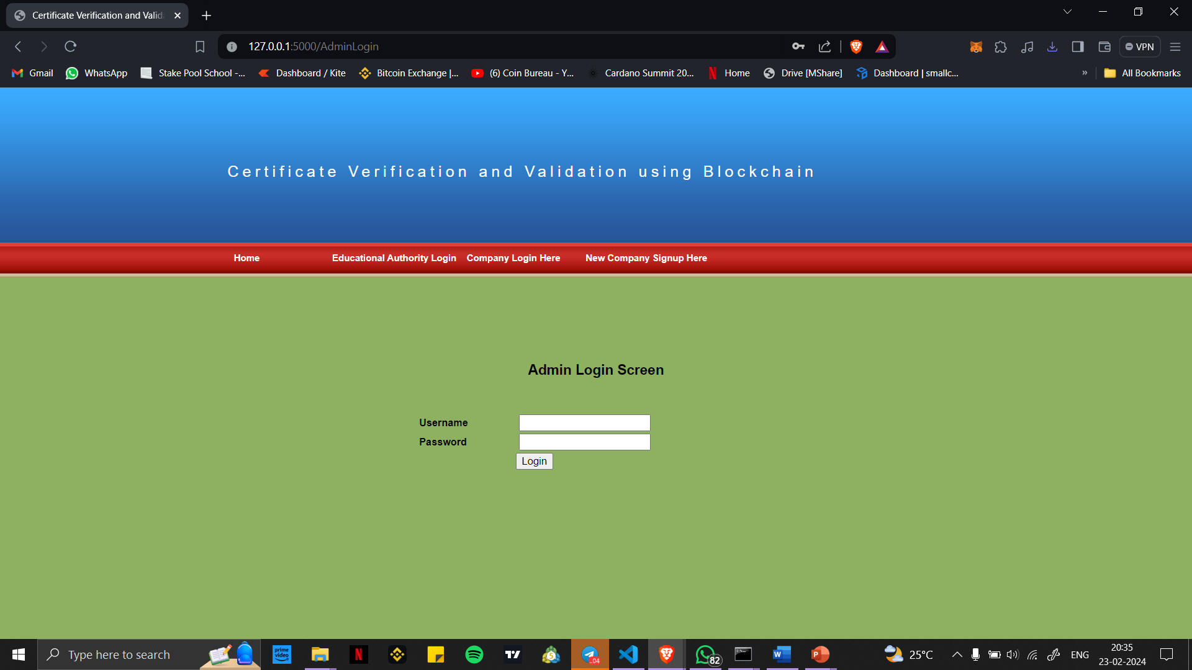

Slide 12
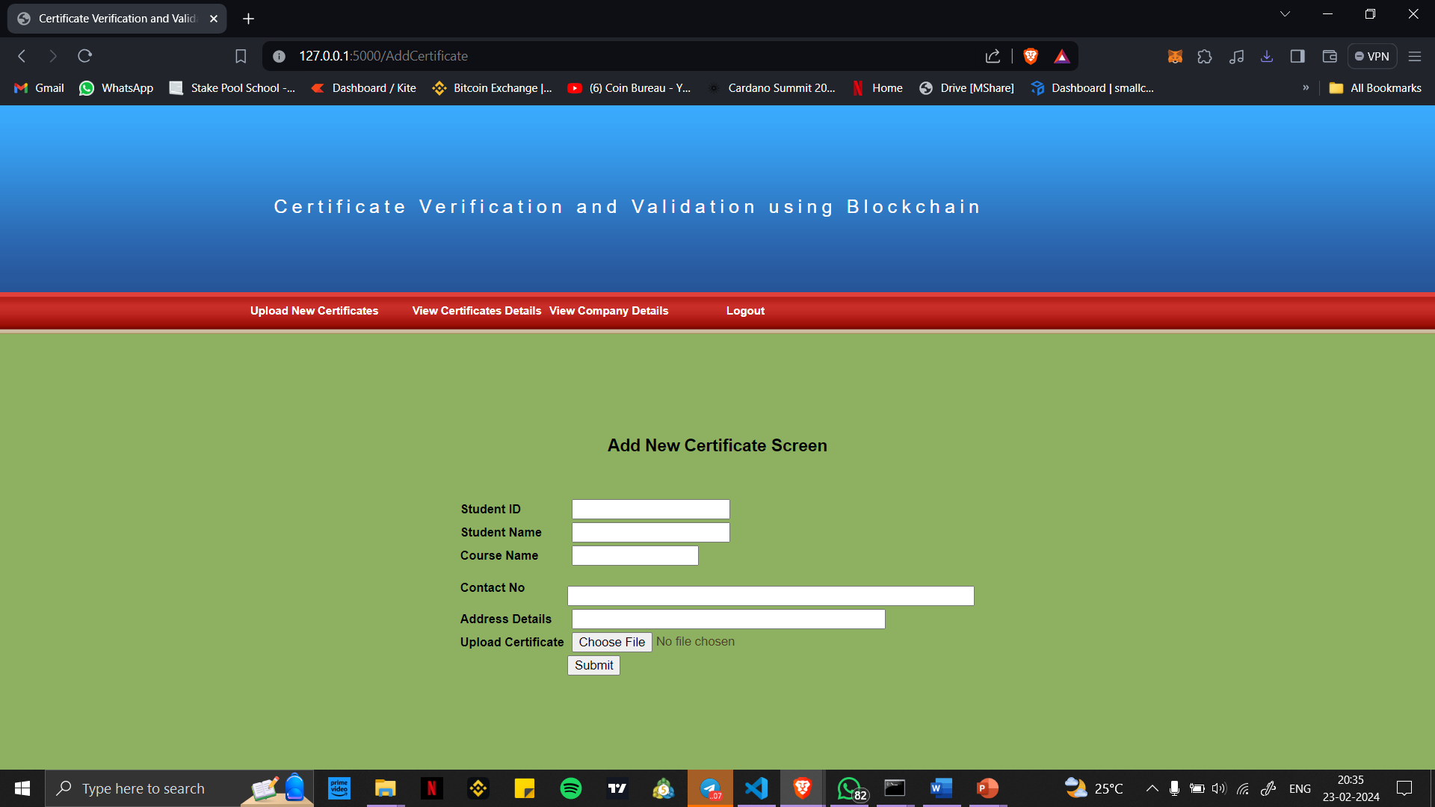

Slide 13
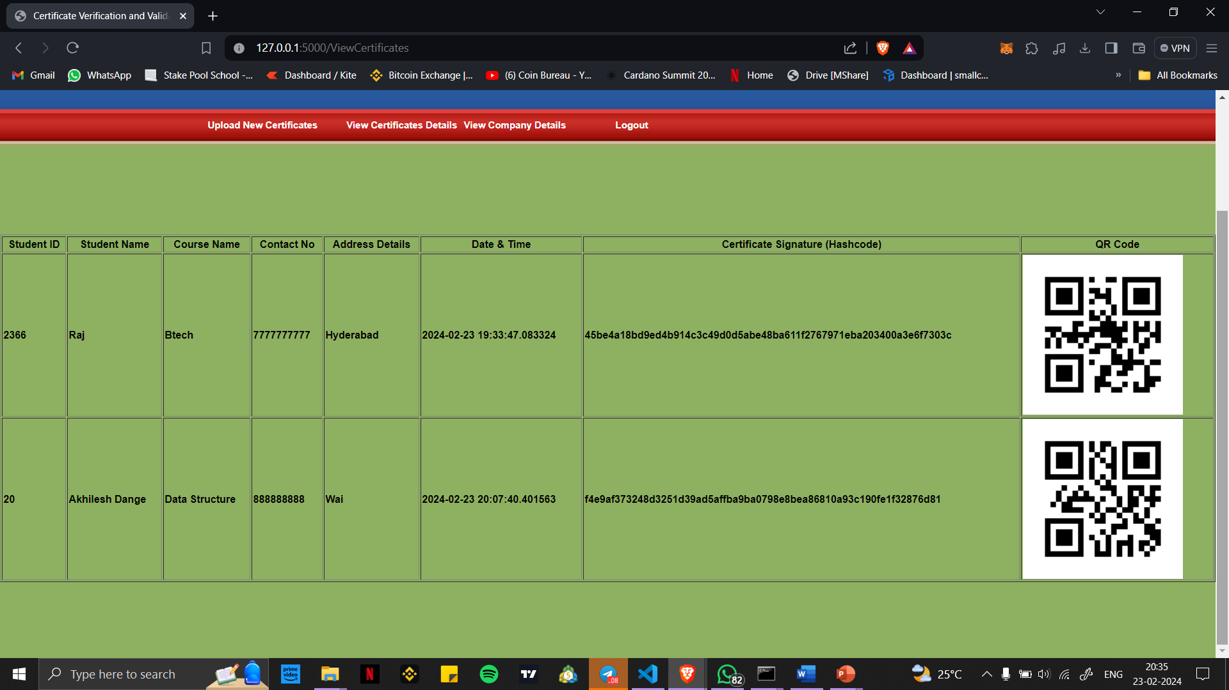

Slide 14
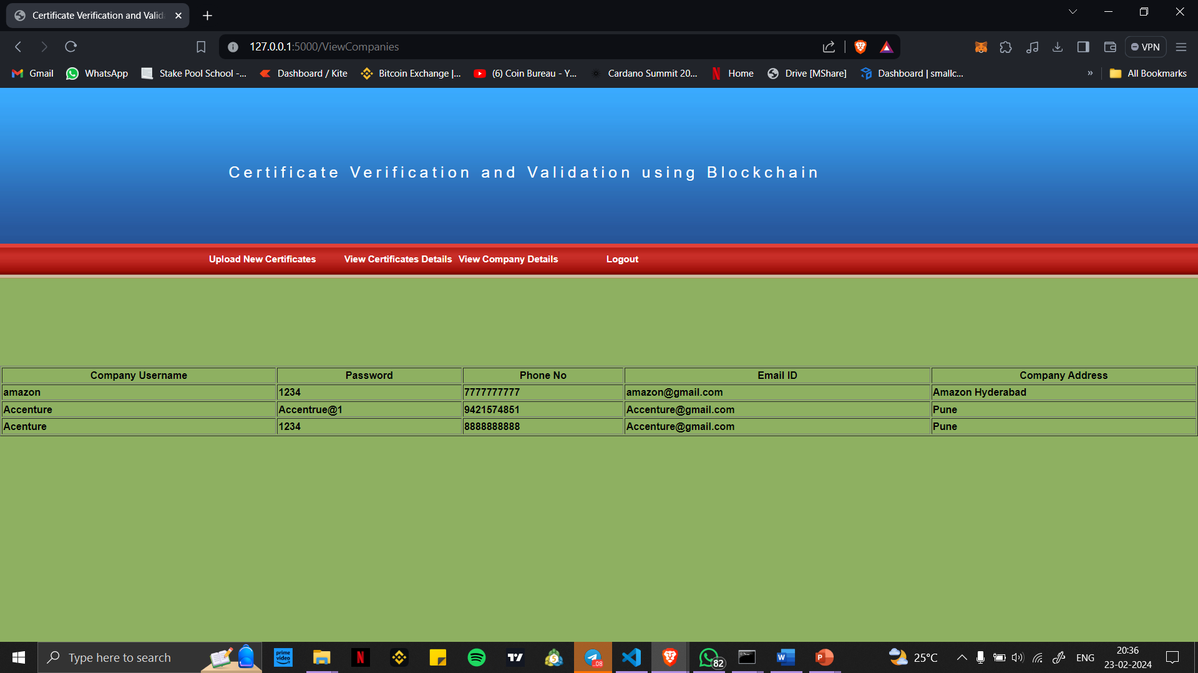

Slide 15
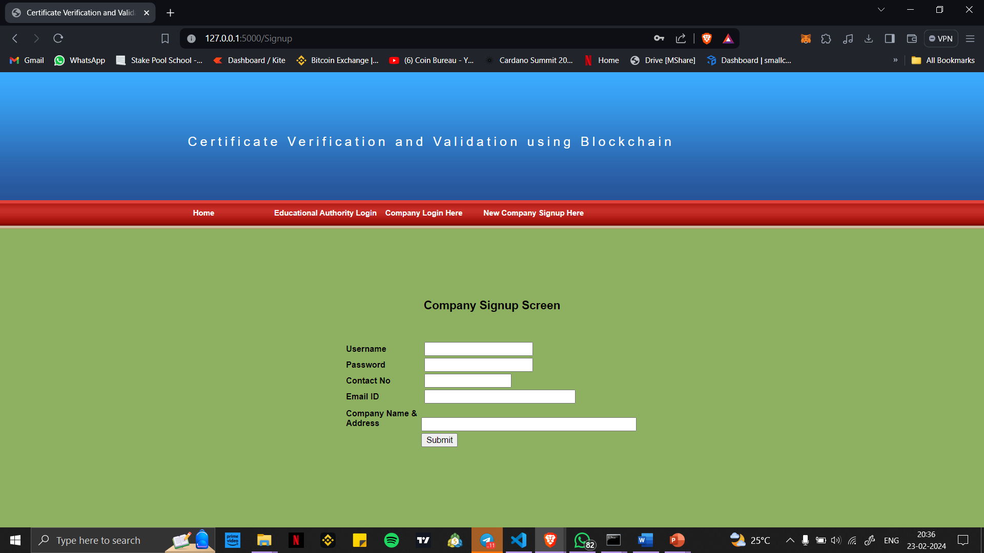

Slide 16
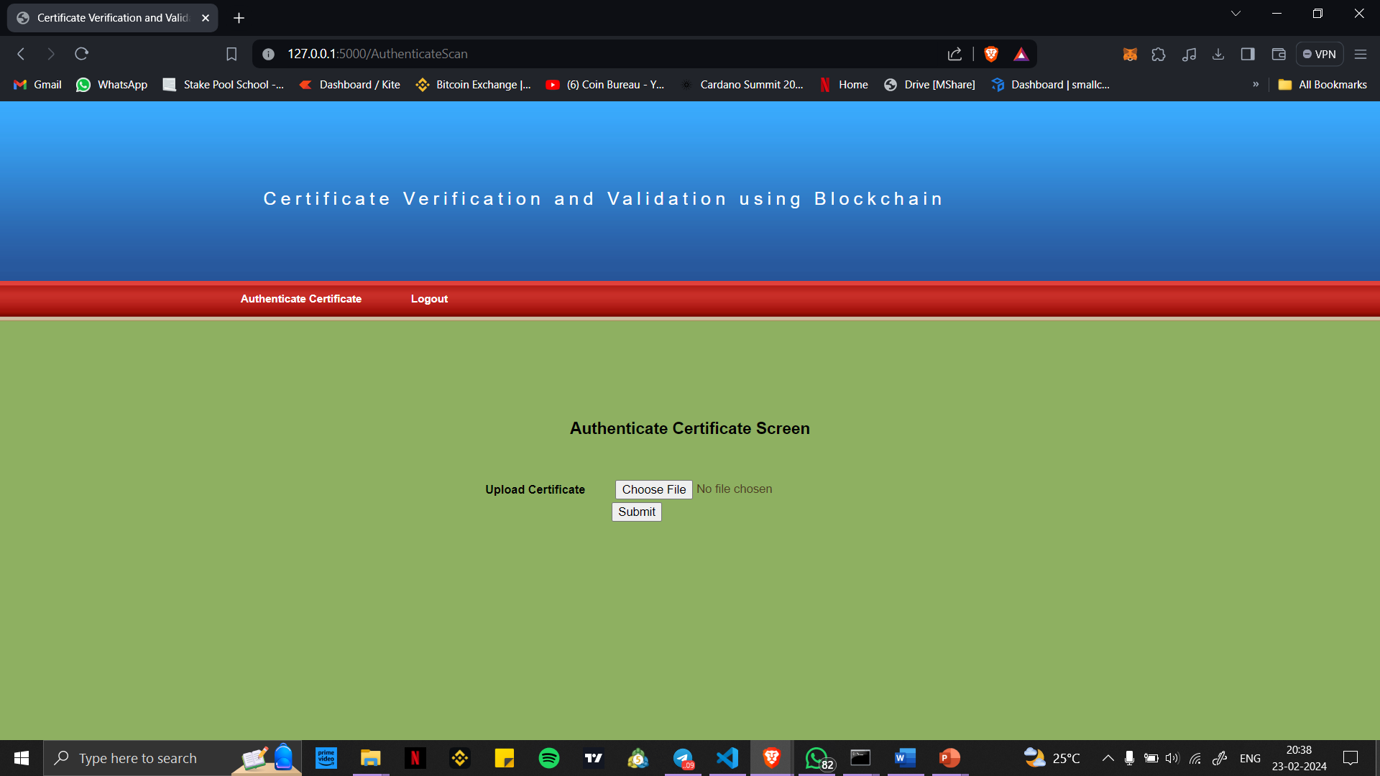

Slide 17
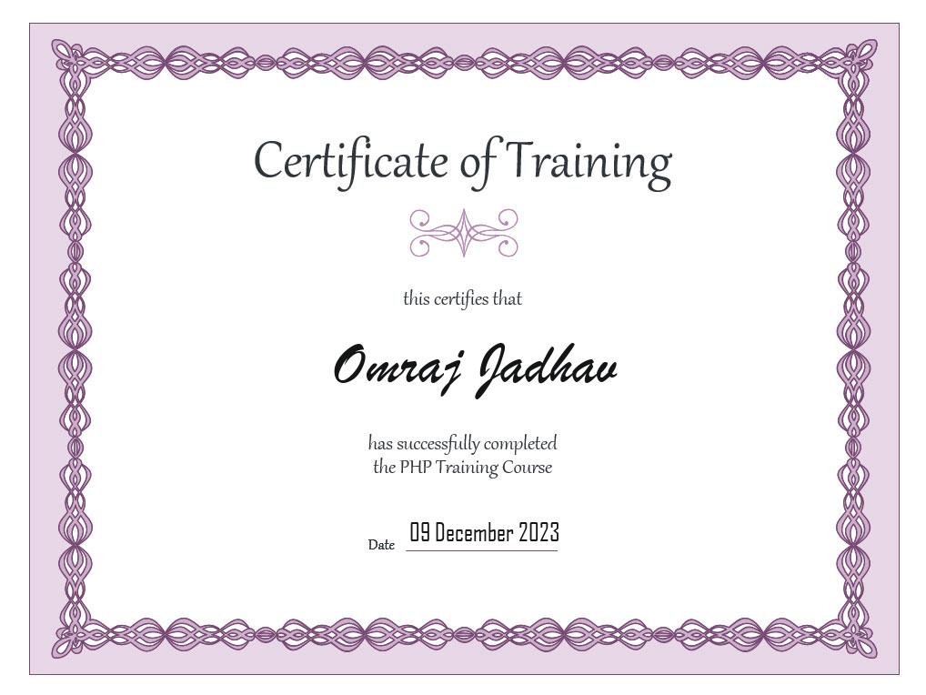

Slide 18
Advantages
Better Security: Our system uses blockchain technology, which is super secure and nearly impossible to hack. This means certificates are safe from forgery and unauthorized access.
Certificates Can't Be Altered: Once certificates are on the blockchain, they can't be changed or faked. This makes sure certificates are always genuine.
Faster Certificate Issuance: Universities and companies can give out certificates directly on the blockchain, skipping the paperwork. This makes it quicker to get certificates.
Easy Verification: People can quickly check if certificates are real by using special links or QR codes. It's fast and hassle-free.
Transparency and Trust: Everything about certificates, from creating them to checking them, is recorded securely. This builds trust and keeps everyone accountable.

Slide 19
Limitation and Future Scope
Needs Internet: Our system depends on the internet for both giving out certificates and checking them. If you're in a place with slow or no internet, it might not work well.
Initial Setup Is Tricky: At the beginning, setting up the system, creating smart contracts, and connecting it to existing systems can be complicated and take some time.
AI and Machine Learning: In the future, we can make our system even smarter by using AI and machine learning. This will help us spot fake certificates more effectively.
All devices Support: We're planning to create mobile apps. This will make it super easy to manage and check certificates using smartphones and tablets.

Slide 20
References
1) "Blockchain-Based Verification of Academic Credentials" by Kimberly Davies (2021): This paper discusses the use of blockchain technology to verify academic credentials and explores its potential benefits for educational institutions and students.
2) "Blockchain-Based Verification of Educational Certificates" by Tarun Kumar and Manoj Sain (2020): This research paper explores how blockchain can be employed to enhance the verification of educational certificates and mitigate issues related to fraud and credential authenticity.
3) "Digital Credential Verification Using Blockchain Technology" by William Turner and Dilantha Silva (2019): The paper discusses the use of blockchain for digital credential verification, offering insights into the practical implementation of this technology in educational contexts.

